Slide 1
The Intensity Frontier at Fermilab
Eric Prebys
Accelerator Physics Center
Fermilab

Slide 2


My Other Job: Director of LARP
The US LHC Accelerator Research Program (LARP) coordinates US R&D related to the LHC accelerator and injector chain at Fermilab, Brookhaven, SLAC, and Berkeley (with a little at J-Lab and UT Austin)
LARP has contributed to the initial operation of the LHC, but much of the program is focused on future upgrades.
The program is currently funded at a level of about $12-13M/year, divided among:
~50%: Magnet research (Nb₃Sn quadrupoles)
~25%: Accelerator research
~25%: Programmatic activities, including support for personnel at CERN
Ask me about the Toohig Postdoctoral Fellowship!!
(I’m not going to say anything about LARP in this talk)
NOT to be confused with this “LARP” (Live-Action Role Play), which has led to some interesting emails
“Dark Raven”

Slide 3
Today’s Talk: Intensity Frontier at Fermilab
Background and Motivation
Near Term Intensity Frontier Program
NOνA
g-2
Mu2e
ORKA
Required accelerator modifications
The Intensity Frontier with Project X
Physics program
Staged approach
R&D Program

Slide 4
Acknowledgments and Apologies
This talk represents the work of countless people
I have borrowed particularly heavily from
Vladimir Nagaslaev
Veleri Lebedev
Steve Holmes
Stuart Henderson
Bob Tschirhart
Milind Diwan
I apologize in advance to the experiments that I will cover lightly or not at all.

Slide 5
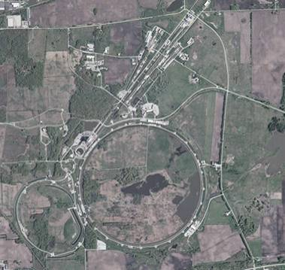
Context (evolving slide)
Fermilab
Built ~1970
200 GeV proton beams
Eventually 400 GeV
Upgraded in 1985
900GeV x 900 GeV p-pBar collisions
Most energetic in the world ever since
Upgraded in 1997
Main Injector-> more intensity
980 GeV x 980 GeV p-pBar collisions
Intense neutrino program
Soon the second most powerful collider
What next???
With the LHC now the highest energy collider, Fermilab must focus on different types of physics.
until recently
For awhile

Slide 6
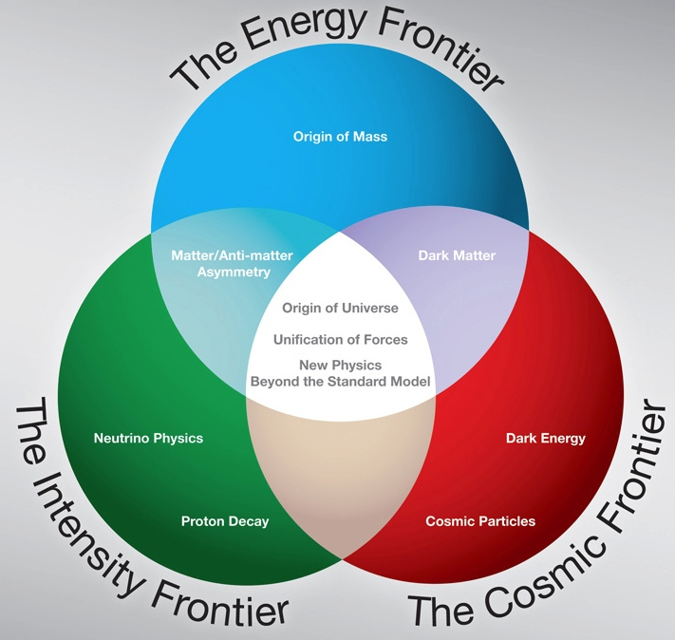
New Directions
To address the changing situation, the DOE’s High Energy Physics Advisory Panel (HEPAP) convened the Particle Physics Prioritization Panel (P5)
In 2008, this panel released a report outlining a strategic plan for US particle physics focused on three “frontiers”
Now that the LHC has taken over the energy frontier, Fermilab’s focus is shifting
LHC
Tevatron
Mu2e

Slide 7
Priorities
As the only remaining US HEP laboratory, Fermilab should continue to do first rate, cutting edge science.
This will include contributions to all three frontiers.
We should strive to keep the “A” in FNAL
That is, support a domestic, accelerator-based program.
We should form a coherent plan that will continue to produce physics results in both the near and far term.

Slide 8
Intensity Frontier Topics
Neutrino Physics
θ₁₃
Mass hierarchy
CP-violation
Majorana vs. Dirac
Precision measurements
Muon to electron conversion
Anomalous muon magnetic moment (g-2).
Precision kaon physics
Electric Dipole Moment (EDM)
Advanced Muon Program
Muon based neutrino factory
Muon collider
Applied Physics
Accelerator-driven sub-critical nuclear reactors
Neutron spallation
Overarching theme

Slide 9
Theory of Neutrino Oscillations
Neutrinos are produced and detected as weak eigenstates (ν_{e} ,ν_{μ}, or ν_{τ} ).
These can be represented as linear combination of mass eigenstates.
If the above matrix is not diagonal and the masses are not equal, then the net weak flavor content will oscillate as the neutrinos propagate.
Example: if there is mixing between the ν_{e} and ν_{μ}: then the probability that a ν_{e} will be detected as a ν_{μ} after a distance L is:
Flavor eigenstates
Mass eigenstates
Distance in km
Energy in GeV
Only measure magnitude of the difference of the squares of the masses.

Slide 10
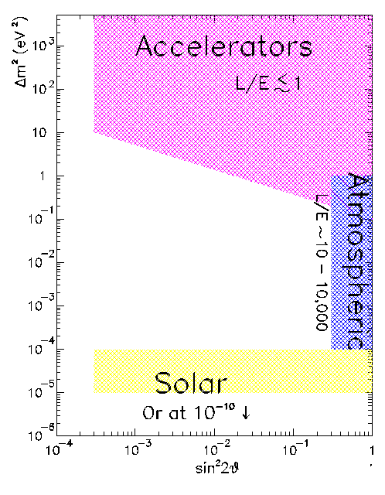
Probing Neutrino Mass Differences
Path length
Different experiments probe different ranges of
Energy
Accelerators use π decay to directly probe ν_{μ} → ν_{e}
Reactors use use disappearance to probe ν_{e} → ?
& Reactors
Cerenkov detectors directly measure ν_{μ} and ν_{e} content in atmospheric neutrinos. Fit to ν_{e}↔ν_{μ} ↔ ν_{τ} mixing hypotheses
Also probe with new generation of “long baseline” accelerator and reactor experiments, MINOS, T2K, etc
Solar neutrino experiments typically measure the disappearance of ν_{e.}

Slide 11
Neutrino Questions
CP Violating Phase
Standard parameterization
What we know What we don’t know
Hierarchy
CP Phase δ_{CP}
Majorana vs. Dirac

Slide 12
Neutrinos: The Long Game
MINOS (2005-2012)
300 kW 120 GeV protons->neutrinos->Sudan Mine
Measure θ₂₃ and Δm₂₃²
NOνA (2013->?)
700 kW 120 GeV protons->neutrinos
New off-axis detector
Measure θ₁₃
Possibly measure hierarchy and δ_{CP}
Long Baseline Neutrino Experiment (LBNE, 2017->?)
~2 MW 60-120 GeV protons->neutrinos
Staged detector at Homestake mine
Nail down θ₁₃, hierarchy, and δ_{CP}
Test unitarity of mixing matrix

Slide 13
Long Term Context and Strategy
~Last decade
~This decade
~Next decade
Future
Fermilab
Intensity Frontier
Energy Frontier

Slide 14
Near Term (~next decade) Physics Program
NOνA off-axis neutrino experiment
Increase 120 GeV proton flux to existing NuMI neutrino line
Build new near and far detectors 10 mrad off-axis
g-2: anomalous magnetic moment of muon
Transport muon storage ring from BNL and repeat experiment
Repeat experiment with increased sensitivity
Mu2e: muon to electron conversion
New experiment to measure the conversion to an electron of a muon which has been captured on a nucleus with a sensitivity of four orders of magnitude over previous experiments.
(proposed) ORKA: K➔πνν
First observed in BNL E-787
Sensitive to BSM physics

Slide 15
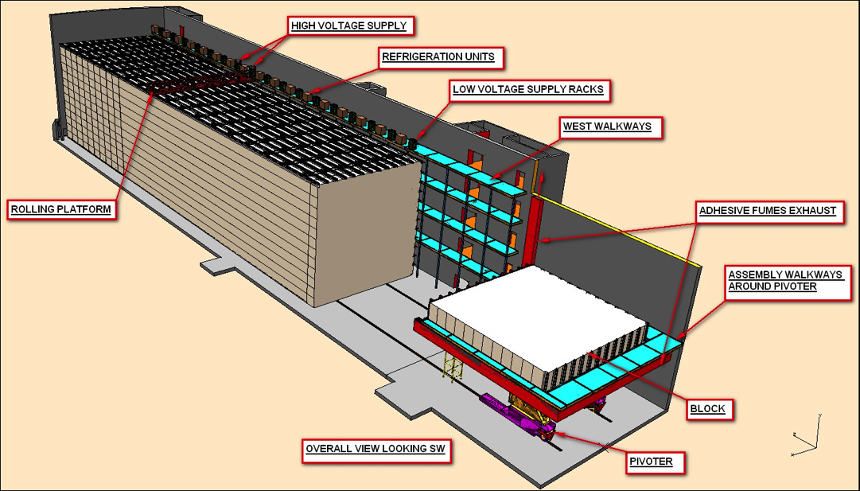
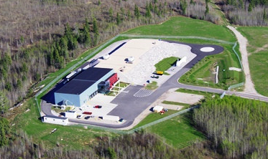
NOνA Experiment

Slide 16
Motivation for Off-Axis Beam
Off-Axis beam provides a narrower energy distribution
This leads to a sharper oscillation spectrum

Slide 17
Events in NOνA

Slide 18
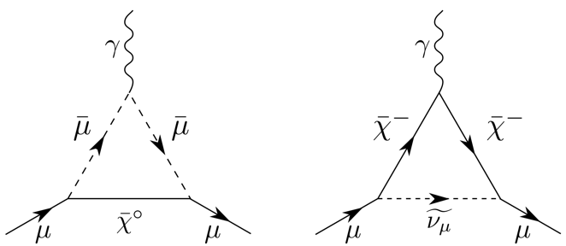
Muon g-2 Experiment Goal
Measurement of the value of muon anomalous magnetic moment, a_{μ}, where to an uncertainty of 16×10⁻¹¹ (0.14 ppm)
Present Situation:
Physics beyond the standard model?
eg

Slide 19
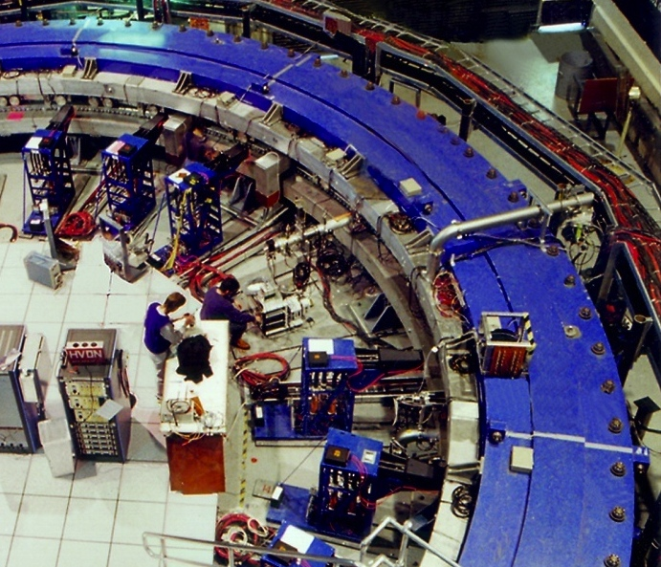
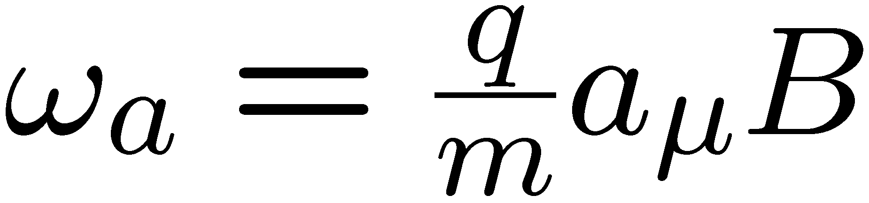
g-2 Experimental Technique
Capture polarized 3.094 GeV/c muons in a uniform magnetic field
Use electric quadrupoles to focus. “Magic” momentum cancels component of precession caused by E field
Remaining precession directly proportional to a_{μ}
Experimental apparatus will be moved from Brookhaven
N(e) vrs time. BNL 2001
e
Momentum
Spin

Slide 20

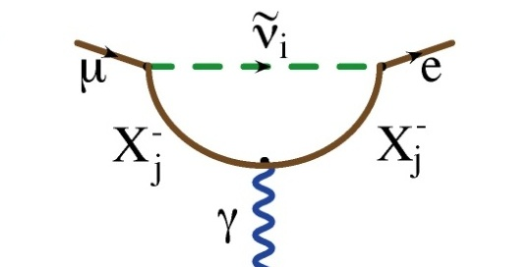
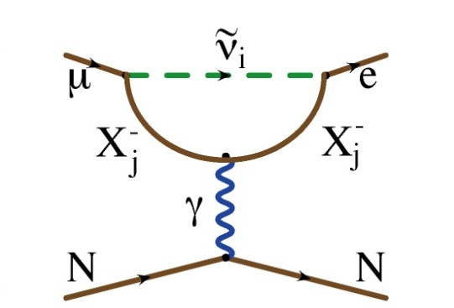
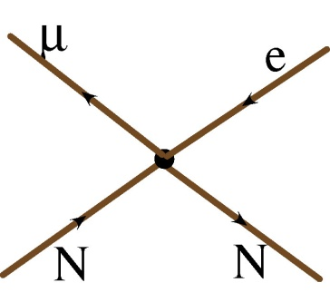
Generic Beyond Standard Model CLFV
Flavor Changing Neutral Current
Dipole (penguin)
Can involve a real photon
Or a virtual photon
?
?
?
Mediated by massive neutral Boson, e.g.
Leptoquark
Z’
Composite
Approximated by “four fermi interaction”
?
?
?

Slide 21

Decay vs. Conversion
Only the “dipole”-like reactions can lead to a decay
However, if we capture a muon on a nucleus, it could exchange either a virtual photon or other (unknown) neutral boson with the nucleus

Slide 22
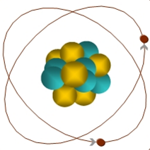
Mu2e: Experimental Signature of μ+N → e+N
When captured by a nucleus, a muon will have an enhanced probability of exchanging a virtual particle with the nucleus.
This reaction recoils against the entire nucleus, producing a mono-energetic electron carrying most of the muon rest energy
μ
~105 MeV e⁻
Similar to μ→eγ, with important advantages:
No combinatorial background.
Because the virtual particle can be a photon or heavy neutral boson, this reaction is sensitive to a broader range of new physics.
Any signal would be unambiguous evidence of physics beyond the standard model.

Slide 23
Example Sensitivities*
Supersymmetry
Compositeness
Predictions at 10⁻¹⁵
Second Higgs doublet
Heavy Neutrinos
Heavy Z’, Anomalous Z coupling
Leptoquarks
*After W. Marciano

Slide 24
Mu2e Beam Needs and Experimental Technique
Eliminate prompt beam backgrounds by using a primary beam consisting of short proton pulses with separation on the order of a muon life time
Design a transport channel to optimize the transport of right-sign, low momentum muons from the production target to the muon capture target.
Design a detector which is very insensitive to electrons from ordinary muon decays
~200 ns
~1.5 μs
Nothing at 10⁻¹⁰ level!
Prompt backgrounds
live window

Slide 25
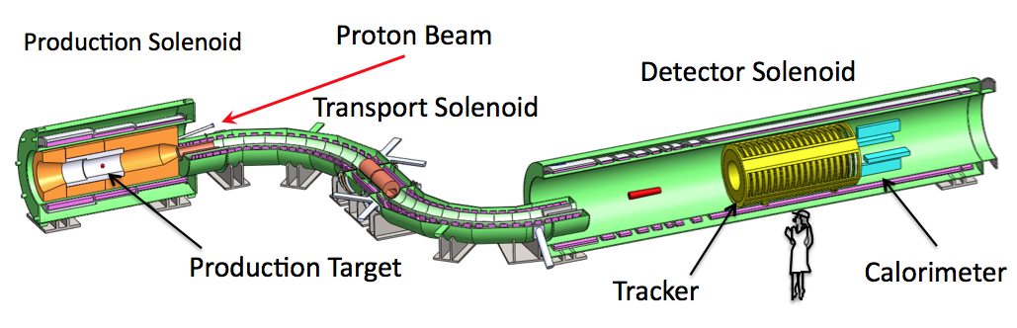
Muon Beam Line and Mu2e Detector
Production Target
Proton beam strikes target, producing mostly pions
Production Solenoid
Contains backwards pions/muons and reflects slow forward pions/muons
Transport Solenoid
Selects low momentum, negative muons
Capture Target, Detector, and Detector Solenoid
Capture muons on Aluminum target and wait for them to decay
Detector blind to ordinary (Michel) decays, with E ≤ ½m_{μ}c²
Optimized for E ~ m_{μ}c²

Slide 26
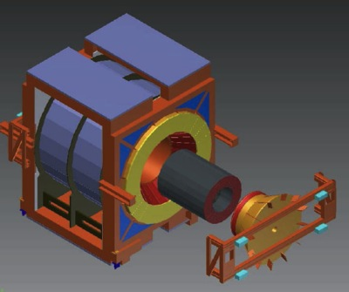
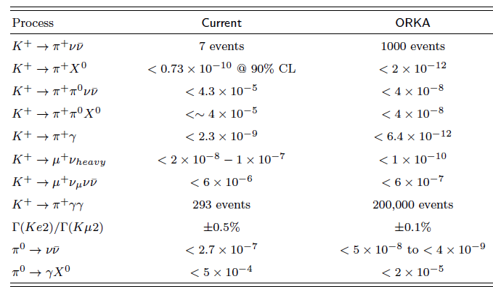
ORKA Κ⁺→π ⁺νν experiment
CDF
ORKA
Unique opportunity to collect 1000 event sample
4th generation experiment
Reuses Tevatron main ring magnets, CDF solenoid, and CDF infrastructure
Would be a day 1 experiment for Stage 1 Project X
Part of a greater Kaon program centered in CDF
ORKA is a long term investment with returns up to and well beyond the start of the LBNE era.

Slide 27
Near Term Challenges for Fermilab
We have proposed an exciting physics program this decade based on leveraging the capabilities of the existing accelerator complex. This involves:
~Doubling total proton output (largely original) 8 GeV Proton Source to supply protons to the masses
➔Proton Improvement Plan (PIP)
Modifying Main Injector loading scheme to increase 120 GeV beam power from 300 kW to 700 kW for NOνA and early LBNL
➔Accelerator and NuMI Upgrade (ANU)
Clever schemes to deliver beam structure required by various experiments
➔Re-tasking hardware formerly used for anti-production and accumulation.

Slide 28
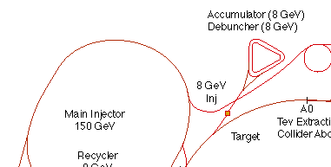
The Fermilab Accelerator Complex
We will use all of this
MiniBooNE/BNB
NUMI

Slide 29
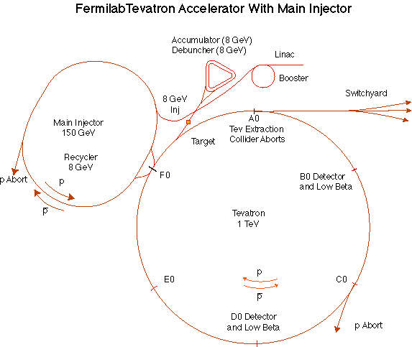
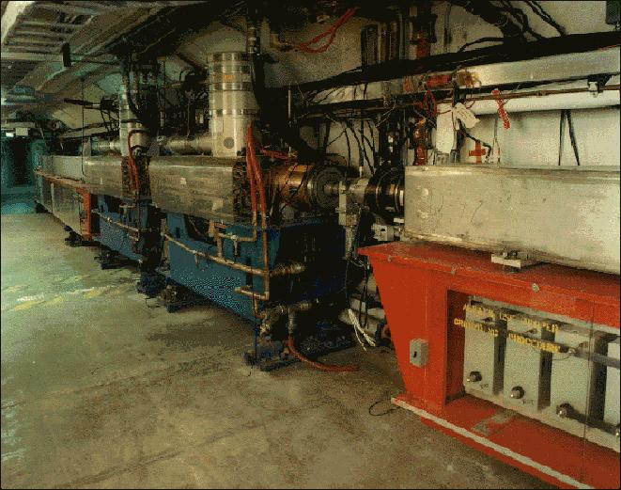
Booster
Accelerates the 400 MeV beam from the Linac to 8 GeV
Operates in a 15 Hz offset resonant circuit
Cannot make required beam structure
That’s why MECO wasn’t proposed there
Sets fundamental clock of accelerator complex
More or less original equipment
40+ years old
Supplying beam to neutrino program and Mu2e will require ~doubling output
Hardware limits ➔ Improve RF system
Radiation limits ➔ Improve acceleration efficiency
➔ “Proton Improvement Plan” (whole separate talk)

Slide 30
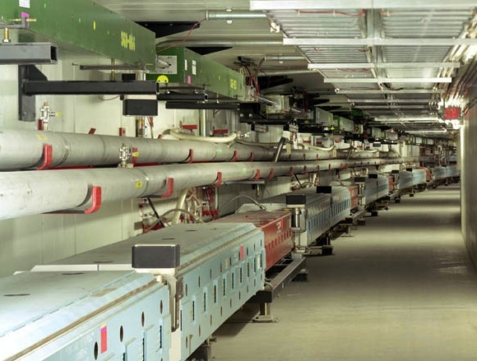
Main Injector/Recycler
Main Injector
Accelerates protons (or pBars) from 8 GeV to 120 or 150 GeV
Can hold up to 12 Booster batches
Recycler
Permanent magnet 8 GeV storage ring
During Tevatron program, used to store pBars
Currently being configured to pre-stack protons for loading into the Main Injector
In the future, it will be used to re-bunch protons for the g-2 and Mu2e experiments.

Slide 31
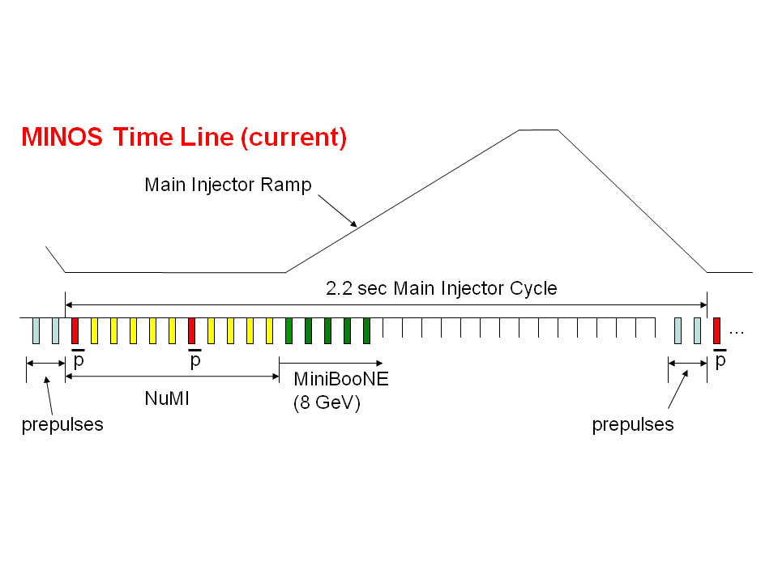
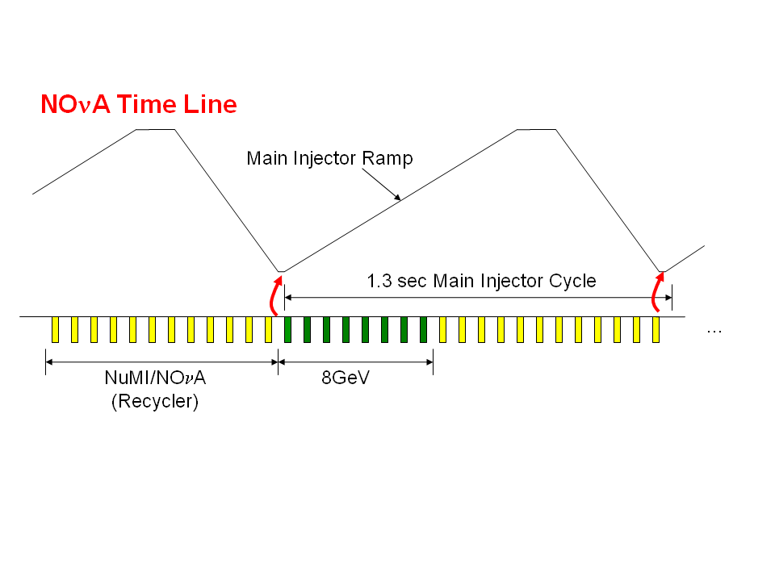
NOνA time line improvements
300 kW
Tevatron era: must allow time at injection energy to load protons into Main Injector
700 kW
Upgrade: a new transfer line will allow us to “prestack” in the Recycler
Up to ~5x10²⁰ protons/year that cannot be used by NOνA

Slide 32
A Tight Fit

Slide 33
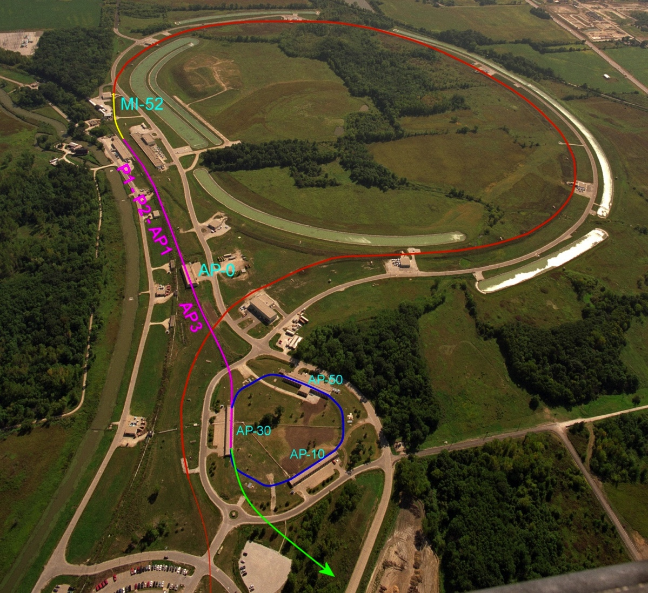
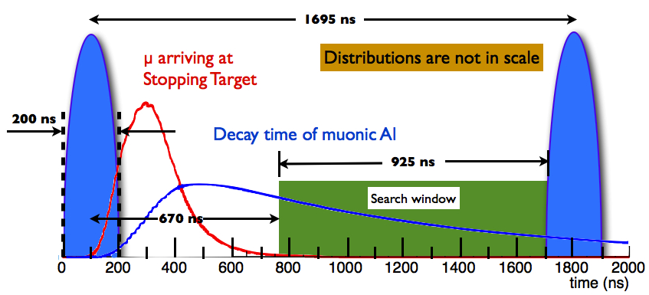
g-2 and Mu2e Proton Delivery
Common to both:
One Booster “batch” is injected into the Recycler (8 GeV storage ring).
4x10¹² protons
1.7 μsec long
It is divided into 4 bunches of 10¹² each
g-2:
Bunches are extracted to a muon production target (former pBar target location)
Muons circulate in Delivery Ring until all pions decay away
Muons are extracted to g-2 precession ring (transported from Brookhaven)
Mu2e:
Bunches are extracted directly to the Delivery Ring
Period = 1.7 μsec
As each bunch circulates, it is resonantly extracted to produce the desired beam structure.
Bunches of ~3x10⁷ protons each
Separated by 1.7 μsec
Main Injector/Recycler
Delivery Ring (formerly pBar Debuncher)
Mu2e
Booster

Slide 34
Resonant Extraction
Extracting all the beam at once is easy, but we want to extract it slowly over ~60 ms (~35,000 revolutions)
Use nonlinear (sextupole) magnets to drive a harmonic instability
Extract unstable beam as it propagates outward
Standard technique in accelerator physics
Unstable beam motion in N(order) turns
Extraction Field
Extracted beam
Lost beam
Septum

Slide 35
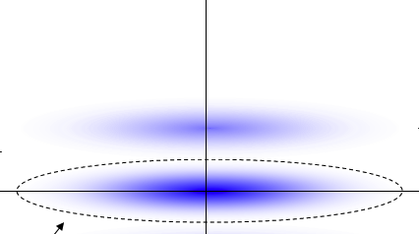
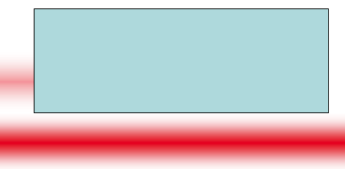
Beam line extinction
A set of resonant dipoles in the beam deflects beam such that only in-time beam is transmitted through a system or collimators:
Think miniature golf!
Use resonant dipoles at two frequencies
½ bunch frequency to sweep out of time beam into collimators
High harmonic to reduce motion during transmission window
At dipole:
At collimator:
Out of time
In time

Slide 36
Accelerator R&D Areas for Near Term Program
Beam control and loss reduction throughout complex
Booster
Main Injector/Recycler
Delivery Ring
Intensity way beyond passive shielding limit
Beam stacking and manipulation in Recycler
Stacking for Neutrinos
Rebunching for g-2 and Mu2e
Resonant extraction from Delivery Ring
Extinction and extinction monitoring for Mu2e
Energy Deposition and Materials Science!!!
Targetry
Collimation
Longevity/shielding of superconducting magnets

Slide 37
Proton Demands
~80kW @ 8 GeV

Slide 38
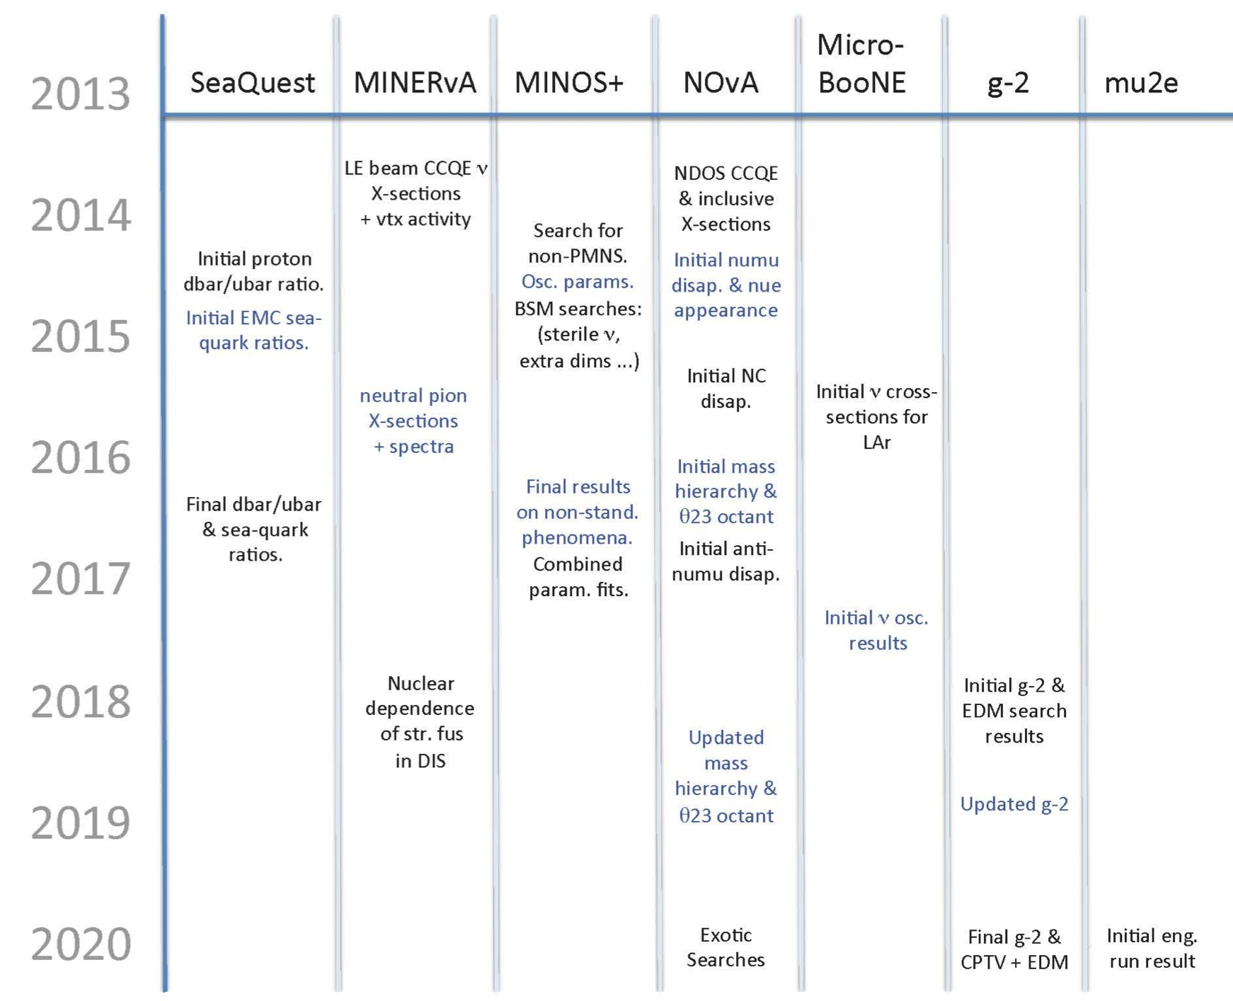
Near Term Physics
Physics

Slide 39
Experimental Sensitivities in Near Term
g-2 will measure the anomalous magnetic moment of the muon to .14 ppm
~factor of 4 better than previous experiment
Mu2e will measure
Initial single event sensitivity of R_{μe}=2x10⁻¹⁷
This represents an improvement of four orders of magnitude compared to the existing limit, or over a factor of ten in effective mass reach. For comparison
TeV -> LHC = factor of 7
LEP 200 -> ILC = factor of 2.5

Slide 40
Example NOνA Sensitivities

Slide 41

Moving Forward
The Intensity Frontier program at Fermilab is limited by the existing proton source
The Linac and Booster are largely 40+ year old original equipment!
In 2007, the Fermilab Long Range Steering Committee recommended the development of a new, high intensity proton source, based on superconducting linac technology developed for the ILC
This project was temporarily named…
Project X

Slide 42

Project X Mission Goals
A neutrino beam for long baseline neutrino oscillation experiments
2 MW proton source at 60-120 GeV
MW-class low energy proton beams for kaon, muon, neutrino, and nuclei based precision experiments
Operations simultaneous with the
neutrino program
A path toward a muon source for
possible future Neutrino Factory
and/or a Muon Collider
Requires ~4 MW at ~5-15 GeV
Possible missions beyond particle physics
Energy and materials applications

Slide 43
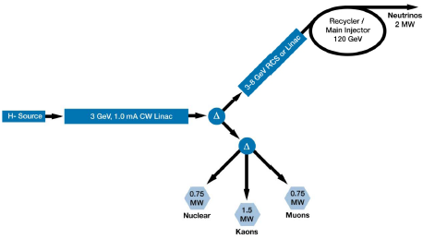
Overview of Project X
The specifications of Project X have undergone many iterations since the initial proposal
Current baseline
3 GeV CW Linac will drive nuclear and rare decay program
Pulsed linac will accelerate beam to 8 GeV for injection into the Recycler/Main Injector to drive a high energy neutrino program

Slide 44
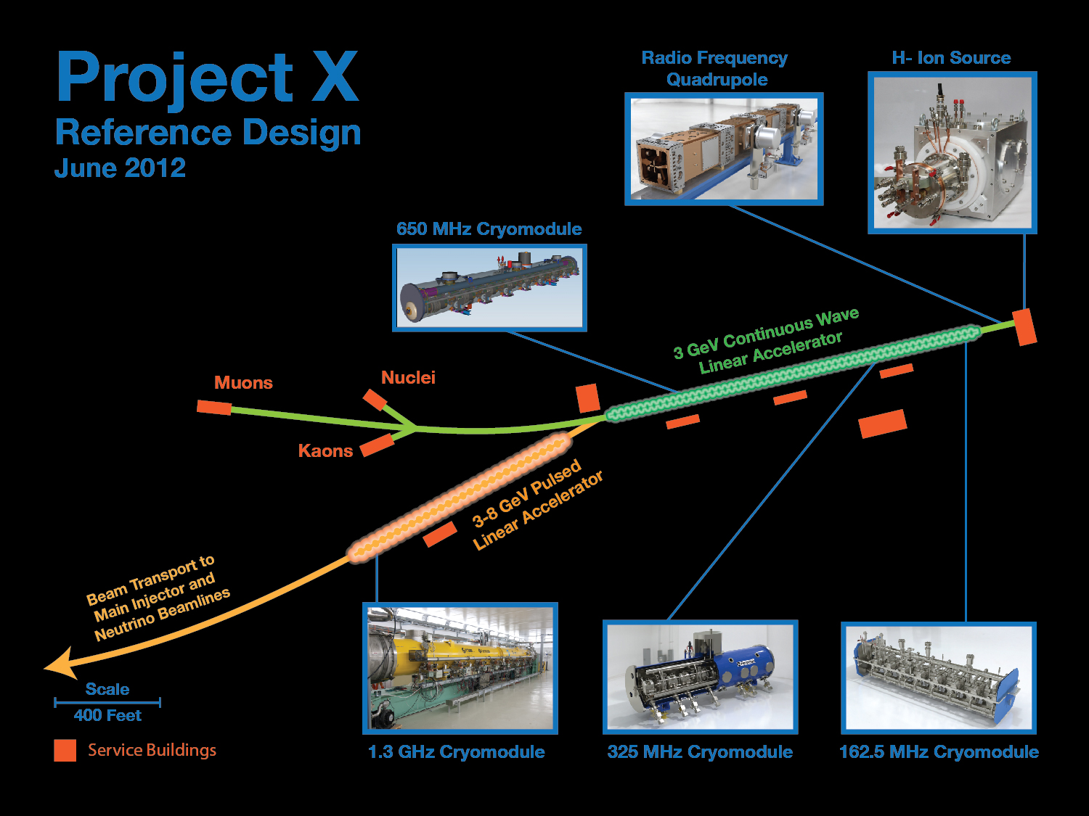
as;lkjfda;lskdjf;salkjfd
1 MW @ 1 GeV
3 MW @ 3 GeV
200 kW @ 8 GeV
2 MW @ 120 GeV

Slide 45
Project X SRF Linac Technology Map
β=0.11
β=0.22
β=0.4
β=0.61
β=0.9
β=1.0
CW
Pulsed
162.5 MHz
2.1-10 MeV
325 MHz
10-160 MeV
650 MHz
0.16-3 GeV
1.3 GHz
3-8 GeV
Section | Freq | Energy (MeV) | Cav/mag/CM | Type
HWR (β_{G}=0.1) | 162.5 | 2.1-10 | 9/6/1 | HWR, solenoid
SSR1 (β_{G}=0.22) | 325 | 10-42 | 16/18/ 2 | SSR, solenoid
SSR2 (β_{G}=0.47) | 325 | 42-160 | 36/20/4 | SSR, solenoid
LB 650 (β_{G}=0.61) | 650 | 160-460 | 42 /14/7 | 5-cell elliptical, doublet
HB 650 (β_{G}=0.9) | 650 | 460-3000 | 152/19/19 | 5-cell elliptical, doublet
ILC 1.3 (β_{G}=1.0) | 1300 | 3000-8000 | 224 /28 /28 | 9-cell elliptical, quad

Slide 46
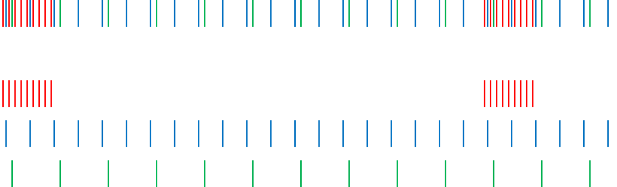
Operating Scenario for High Power Campus
1 μsec period at 3 GeV
Muon pulses (12e7) 162.5 MHz, 80 nsec 700 kW
Kaon pulses (12e7) 27 MHz 1540 kW
Nuclear pulses (12e7) 13.5 MHz 770 kW
Ion source and RFQ operate at 4.4 mA; 77% of bunches are
chopped @ 2.1 MeV ⇒ maintain 1 mA over 1 μsec
Separation scheme
1 μsec
Transverse rf splitter

Slide 47
Staged Approach to Project X

Slide 48
Staging Plan
Stage 1
1 GeV × 1 mA CW linac injecting into existing (upgraded) Booster
Connection to Muon Campus
New High Power Spallation Campus (1 GeV)
Stage 2
Add 1-3 GeV × 1 mA CW linac, still injection into Booster
20 Hz Booster upgrade
New High Power Muon and Kaon Campus (3 GeV)
Stage 3 (Reference Design)
Add 3-8 GeV × 1 mA @4.3% duty factor pulsed linac injecting into (upgraded) Recycler/MI
Connection to Short Baseline Neutrino Campus
Stage 4 (Beyond the Reference Design)
Current upgrade of CW and pulsed linac: 5 mA x 10% DF = 4 MW @ 8 GeV
Main Injector/Recycler upgrades
LBNE target upgrade
Step toward a NF or MC

Slide 49
Stage 1
Increases beam power throughout the accelerator complex:
power to muon experiments (Mu2e, g–2) × 10
power to 8-GeV-based neutrino experiments (MicroBooNE) × 3
power to MI experiments (LBNE, SeaQuest,...) × 1.5.
• Enables a suite of new (for Fermilab) experiments
electric-dipole measurements
ultracold neutrons, e.g., n-ñ oscillations.

Slide 50
Example Research Program, definitive space of accelerator parameters on PXPS Indico site
Project X Campaign
Program: | Onset of NOvA operations in 2013 | Stage-1: 1 GeV CW Linac driving Booster & Muon, n/edm programs | Stage-2: Upgrade to 3 GeV CW Linac | Stage-3: Project X RDR | Stage-4: Beyond RDR: 8 GeV power upgrade to 4MW
MI neutrinos | 470-700 kW** | 515-1200 kW** | 1200 kW | 2450 kW | 2450-4000 kW
8 GeV Neutrinos | 15 kW +0-50kW** | 0-42 kW* + 0-90 kW** | 0-84 kW* | 0-172 kW* | 3000 kW
8 GeV Muon program e.g, (g-2), Mu2e-1 | 20 kW | 0-20 kW* | 0-20 kW* | 0-172 kW* | 1000 kW
1-3 GeV Muon program, e.g. Mu2e-2 | ----- | 80 kW | 1000 kW | 1000 kW | 1000 kW
Kaon Program | 0-30 kW** (<30% df from MI) | 0-75 kW** (<45% df from MI) | 1100 kW | 1870 kW | 1870 kW
Nuclear edm ISOL program | none | 0-900 kW | 0-900 kW | 0-1000 kW | 0-1000 kW
Ultra-cold neutron program | none | 0-900 kW | 0-900 kW | 0-1000 kW | 0-1000 kW
Nuclear technology applications | none | 0-900 kW | 0-900 kW | 0-1000 kW | 0-1000 kW
# Programs: | 4 | 8 | 8 | 8 | 8
Total max power: | 735 kW | 2222 kW | 4284 kW | 6492 kW | 11870kW
* Operating point in range depends on MI energy for neutrinos.
** Operating point in range depends on MI injector slow-spill duty factor (df) for kaon program.

Slide 51
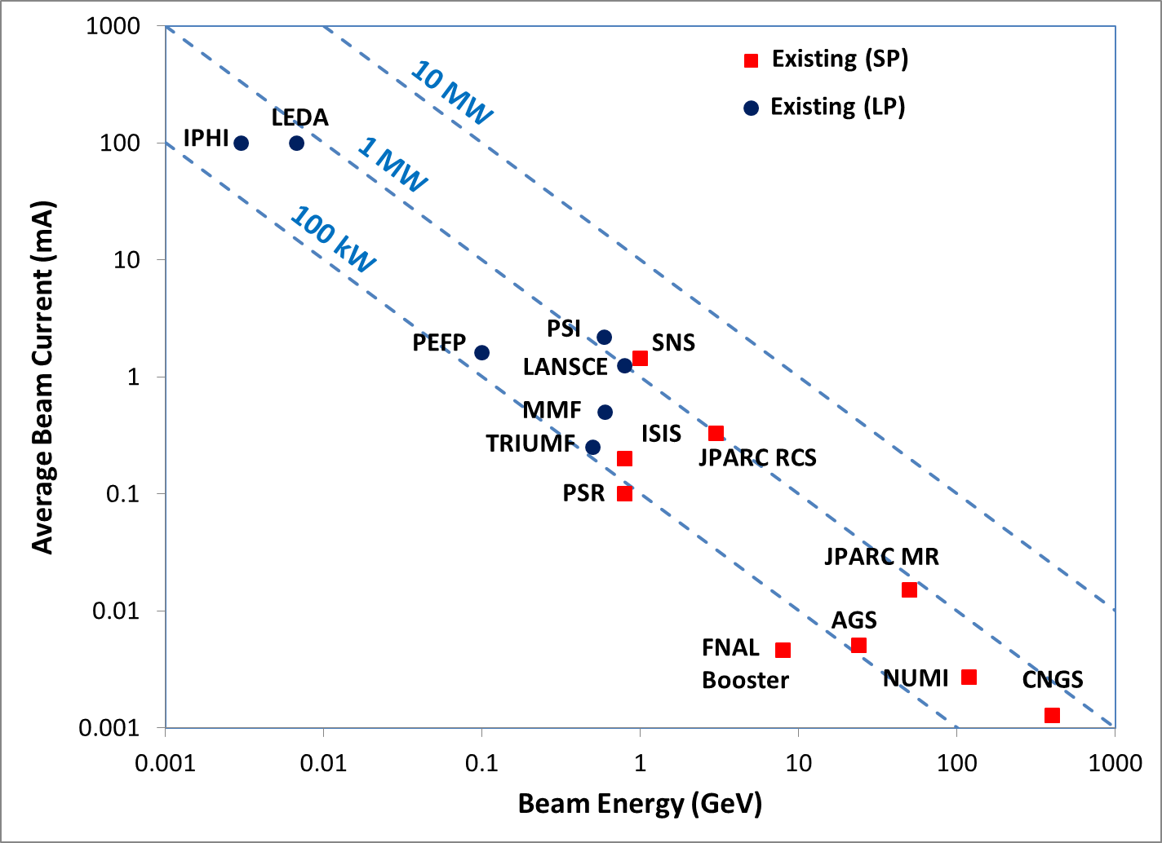
The Beam Power Landscape
Project-X

Slide 52
Evolution of the US Neutrino Program

Slide 53
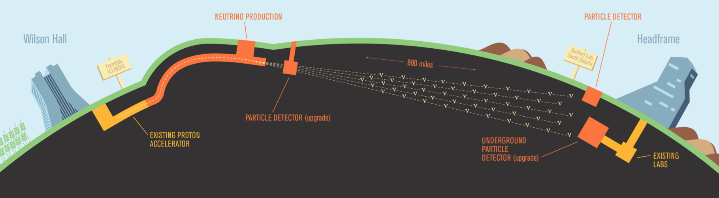
Staged LBNE
Initial concept
New 2MW beam line
Underground detector 1300 km away at Deep Underground Sience and Engineering Lab (DUSEL, Homestake Mine
~$1.5B = too expensive
Staged approach
Start with 700 kW beam+ 10 kt LAR detector at surface
Upgrade to Project X beam and 35 kt underground detector

Slide 54
Signals in Ultimate LBNE

Slide 55
Evolution of Neutrino Sensitivity

Slide 56
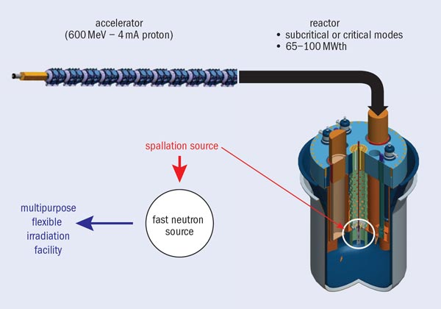
Other Uses for Project X Low Energy CW Beam
Test bed for Accelerator Driven Subcritical Reactor
Driver for a muon based neutrino factory
Neutrons, neutrons, neutrons

Slide 57
Project X R&D Program
Goal is to be prepared for a construction start in 2017
Most likely, Stage 1
Goal of the R&D Program is to mitigate risk: technical/cost/schedule
Technical Risks
Front End
Unique capabilities of PX are enabled by the front end
CW ion source through SSR1
H- injection system
Booster in Stage 1, 2; Recycler in Stage 3
High Intensity Recycler/Main Injector operations
High Power targets
Cost Risks
Superconducting rf
Cavities, cryomodules, rf sources – CW to long-pulse
All of these elements are required at Stage 1

Slide 58
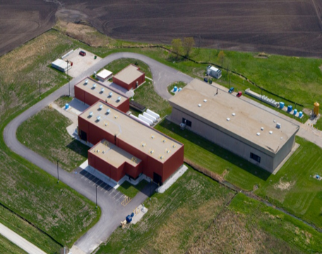
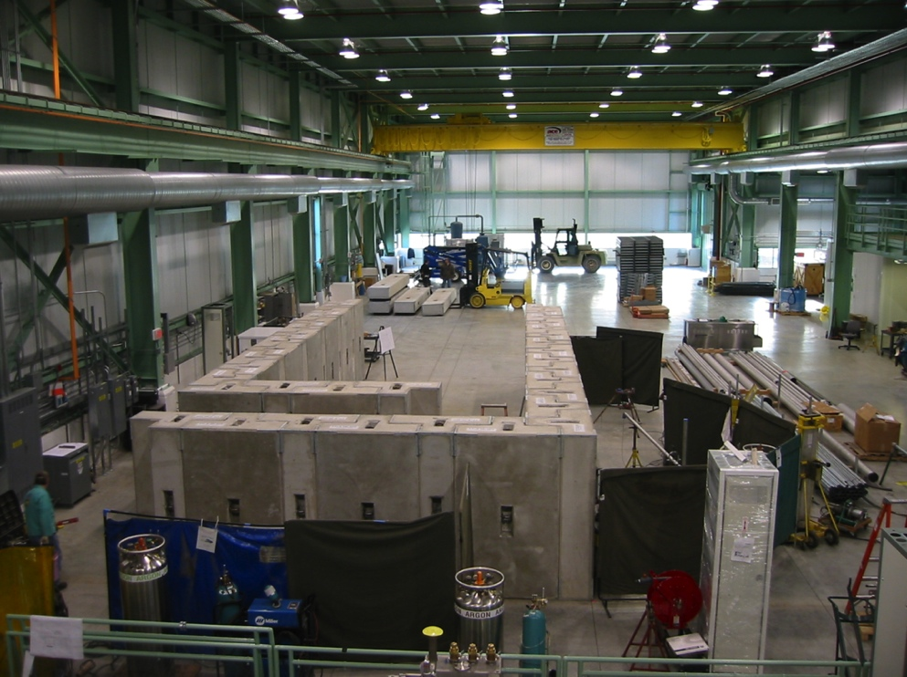
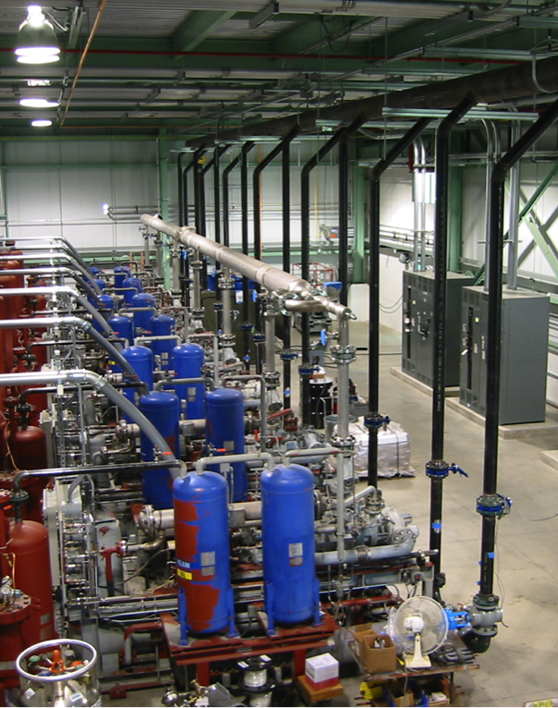
Project X Injector Experiment
Being built in conjunction with the Advanced Superconducting Test Accelerator (ASTA)
ASTA
PXIE

Slide 59
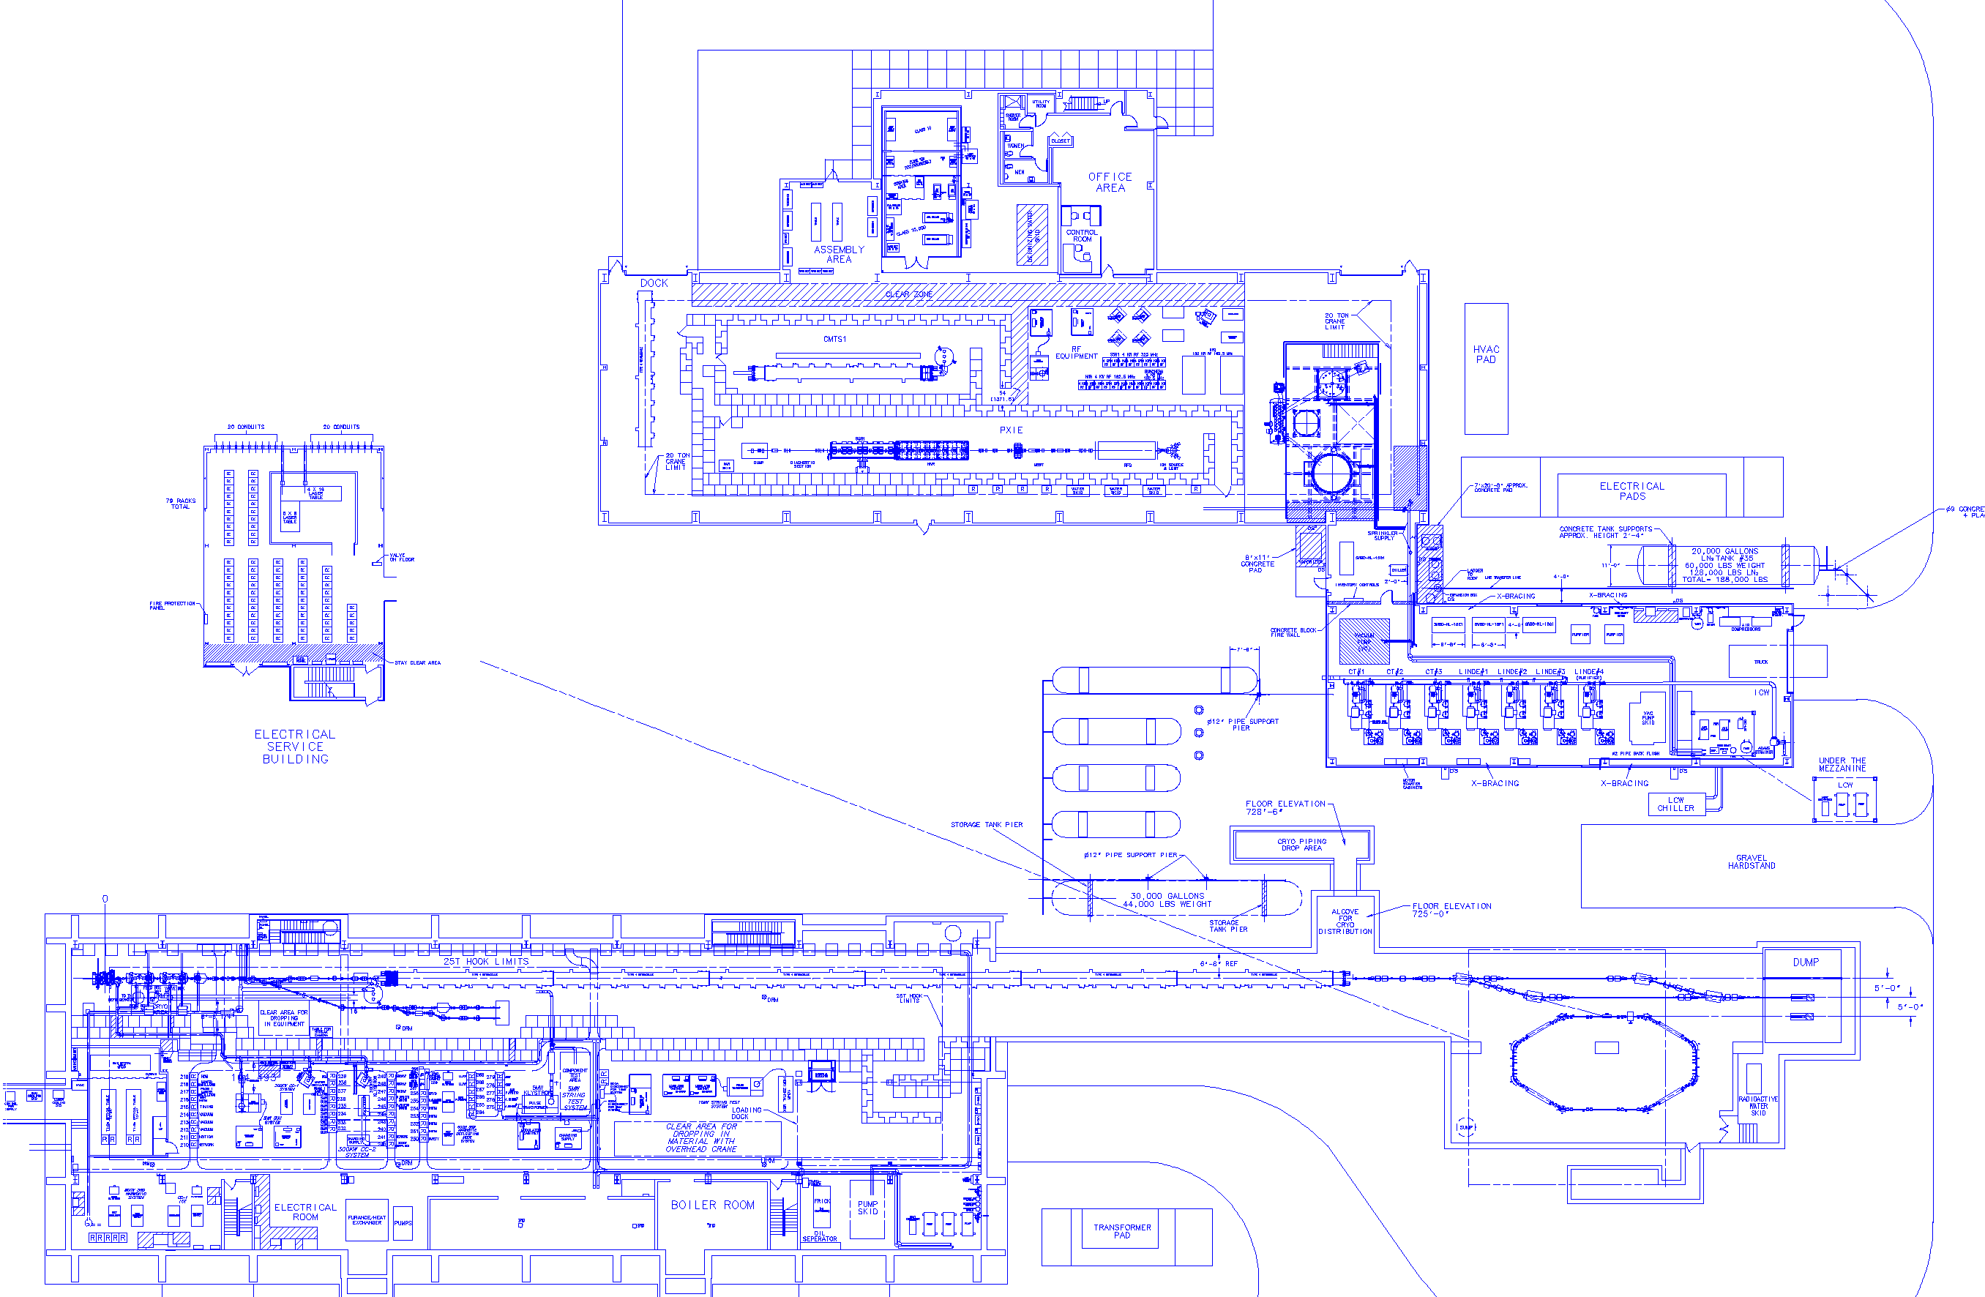
SRF Test Facility Complex
CMTF Main Bldg.
14,700 sq. ft. high bay
5,000 sq. ft. low bay
Cryomodule Test Facility
(CMTF)
Cryomodule
Test Stand 1
Cleanroom
Cryogenic
Cold Boxes
Compressor Bldg. 5,300 sq. ft. high bay
PXIE Accelerator
Pass Thru Line
Existing NML Building
Test Beam Lines
Proposed ASTA Accelerator (nominal 3 CM up to 6 CM)
IOTA Ring
Beam
Absorbers

Slide 60
PXIE Structure
30 kV ion source and LEBT (5 mA nominal, 10 mA max)
Low Energy Beam Transport (LEBT) with beam pre-chopping for machine tuning
2.1 MeV RFQ
Medium Energy Beam Transport (MEBT, ~10 m long)
2 SC cryomodules accelerating beam to 20-30 MeV
High Energy Beam Transport (HEBT)
50 kW beam dump
Total Length: ~40 m

Slide 61
PXIE Goals
Validate the Project X concept and eliminate technical risks (Most risks are related to the frontend)
CW RFQ (reliability,...)
Bunch-by-bunch chopper (kicker and absorber)
MEBT/HWR interface (vacuum, differential pumping, micro-particle migration to HWR through/from MEBT)
High-current beam acceleration in HWR and SSR1
Loss of RFQ longitudinal tails
Halo generation by beam space charge
Extinction for the removed bunches <10⁻⁹ – as desired by -to-e experiment (no formal specification)
Obtain experience in design and operation of SC cryo-modules
SSR1 cryomodule will be designed and built by Fermilab

Slide 62
Test Components
162.5 MHz RFQ
ION Source: 5-15 mA CW
325 MHz SSR String
162.5 MHz HWR String

Slide 63
Bunch by Bunch Chopping
Recall, experimental bunch structure to the three beam lines is produced by timing the bunches with respect to a fixed frequency deflecting cavity (~77% of bunches dumped!)
This is done with two kickers and a dump in the MEBT

Slide 64
Bunch by Bunch Chopping
Kicker
Remember, β<<1
Absorber
Capacity: 10 mA @ 2.1MeV = 21kW (σ = 2 mm)
Molybdenum alloy (TZM)
T_{max} = 1050° C on beam absorbing surface.

Slide 65
Conclusion
In response to the startup of the LHC, Fermilab has proposed a broad, cutting edge intensity frontier research program, which will produce high quality scientific results for the next two decades.
There are many exciting challenges and opportunities along the way.
Thank you for your attention!

